Slide 1
CSE 3203
Digital Signal Processing
Instructor: Nayeema Islam

Slide 2
Class Schedule
Day | Class Time | Room No.
Monday | 8.30-9.55 | 601
Tuesday | 8.30-9.55 | 601
Wednesday | 8.30-9.55 | 601

Slide 3

Reference Book
Digital Signal Processing (4th Edition), J. Proakis and D. Manolakis Prentice Hall, 4 edition, (2006)

Slide 4
Prerequisite
Data Communications
Trigonometry
Calculus

Slide 5
Evaluation
Marks for the course will be calculated as follows:
Category | Marks
Mid-Term Examination 1 | 10%
Mid-Term Examination 2 | 10%
Attendance | 10%
Final Exam | 70%
Total | 100%

Slide 6
Introduction to DSP
lecture 1

Slide 7
Fundamentals >> Signals
A signal is defined as a single-valued function of one or more independent variables which contain some information.
A signal is also defined as a physical quantity that varies with time, space or any other independent variable. A signal may be represented in time domain or frequency domain. Human speech is a familiar example of a signal. Electric current and voltage are also examples of signals.
Examples of independent variables are time, distance, position, temperature and pressure.

Slide 8
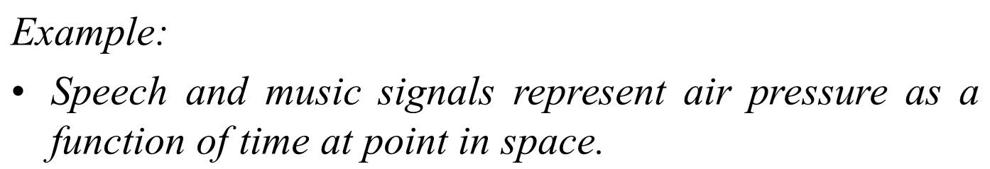
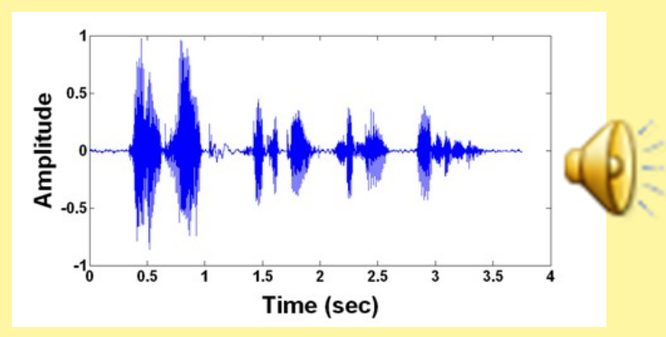
Fundamentals >> Signals

Slide 9
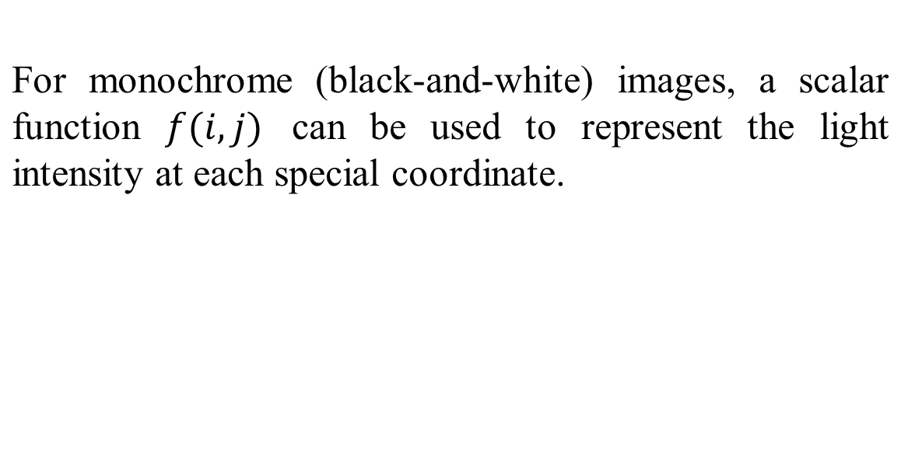

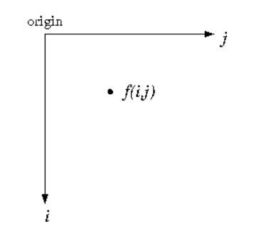
Fundamentals >> Signals

Slide 10
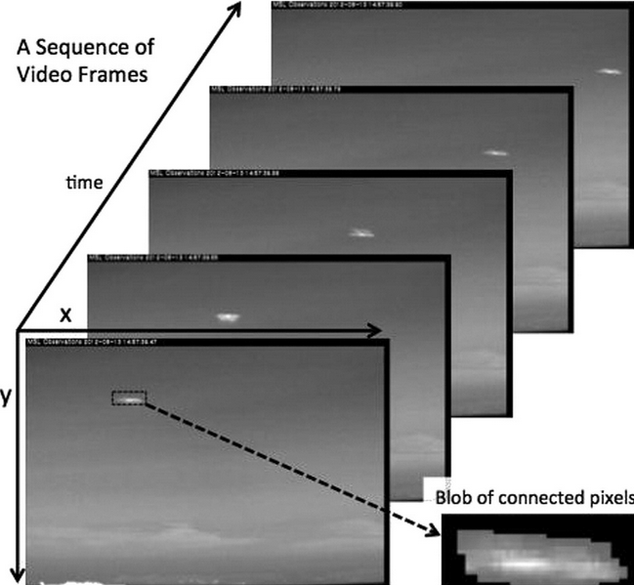
Fundamentals >> Signals
Example:
The video signal in television consists of a sequence of images, called frames and is a function of three variables: two spatial coordinates and time.

Slide 11
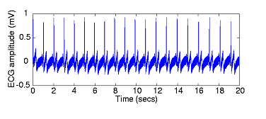
Independent Variable Dimensionality
A signal can be a function of one or more independent variables.
If a signal depends on only one independent variable, it is called a one- dimensional signal.
Time is often the independent variable. Example: Electrical activity of the heart recorded with the electrocardiogram (ECG).

Slide 12

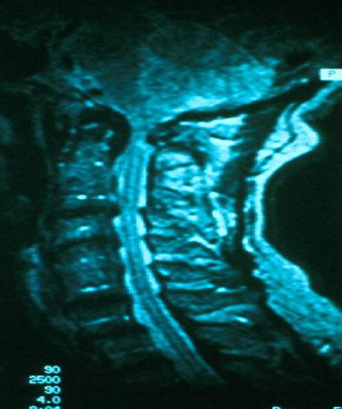
The independent variable may be a spatial variable such as in image. An image can be represented by brightness as a function of two spatial variables (position). It can be mathematically written as f=I(x,y).

Slide 13
Continuous Time signal
A signal x(t) is said to be a continuous-time signal if it is defined for all time t i.e., the independent variable is continuous.
Examples: A speech signal as a function of time, atmospheric pressure as a function of altitude.
A continuous-time signal can be represented by a function x(t) where −∞ < t < ∞.

Slide 14
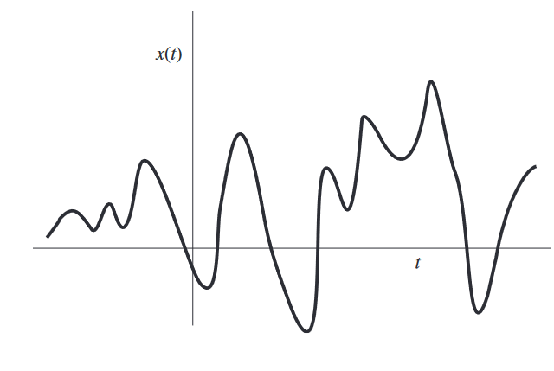
Continuous Time signal
Figure represents an example of a continuous- time signal whose amplitude varies continuously over time.

Slide 15
Discrete Time signal
Discrete time signals are defined only at discrete times, and consequently, for these signals, the independent variables takes on only a discrete set of values.
Examples
  Average budget tabulated against family size.
  Crime rate tabulated against total population.
  Stock market variation over time.
A discrete-time signal can be represented as a function
x[n] where −∞ < n < ∞

Slide 16
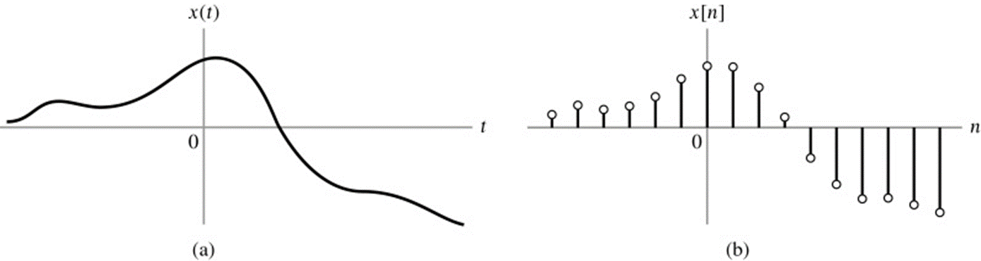
Representation of x(t) as a discrete-time signal x[n]

Slide 17
Representation a discrete-time signals
There are following four ways of representing discrete-time signals:
Graphical representation
Functional representation
Tabular representation
Sequence representation

Slide 18
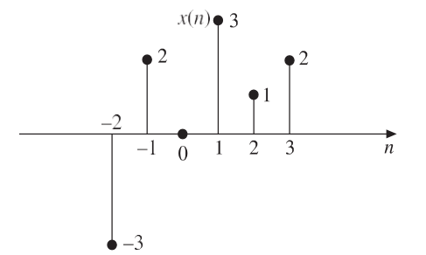
Graphical Representation
Consider a single x (n) with values x[-2] = -3, x[-1] = 2, x[0] = 0, x[1] = 3, x[2] = 1 and x[3] = 2

Slide 19
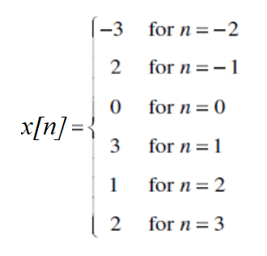
Functional Representation
In this, the amplitude of the signal is written against the values of n. Consider a single x [n] with values x[-2] = -3, x[-1] = 2, x[0] = 0, x[1] = 3, x[2] = 1 and x[3] = 2

Slide 20
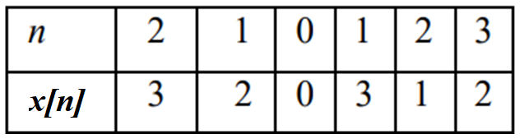


Tabular Representation
In this, the sampling instant n and the magnitude of the signal at the sampling instant are represented in the tabular form. Consider a signal x [n] with values x[-2] = -3, x[-1] = 2, x[0] = 0, x[1] = 3, x[2] = 1 and x[3] = 2.

Slide 21

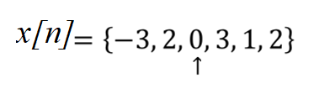

Sequence Representation
The arrow mark ↑ denotes the n = 0 term. When no arrow is indicated, the first term corresponds to n = 0.
So a finite duration sequence, that satisfies the condition x[n] = 0 for n < 0 can be represented as:

Slide 22
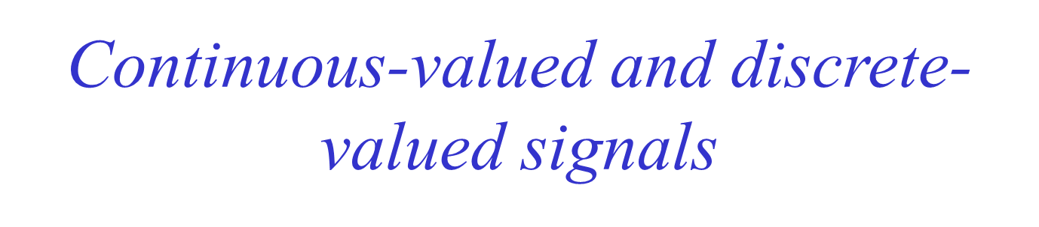
Continuous-valued signals
If a signal takes on all possible values on a finite or an infinite range.
Discrete-valued signals
If the signal takes on values from a finite set of possible values
Continuous signal
A continuous-time signal having a set of continuous value
Digital signal
A discrete-time signal having a set of discrete-value

Slide 23
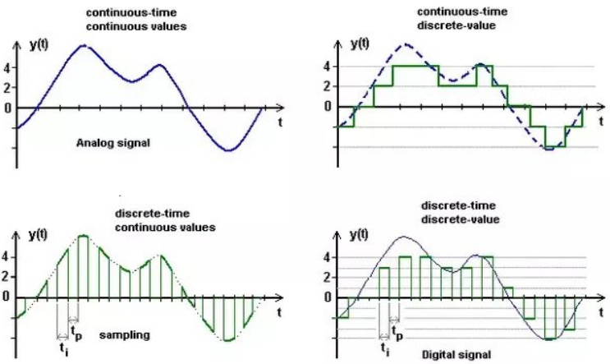
Continuous-valued and discrete- valued signals

Slide 24
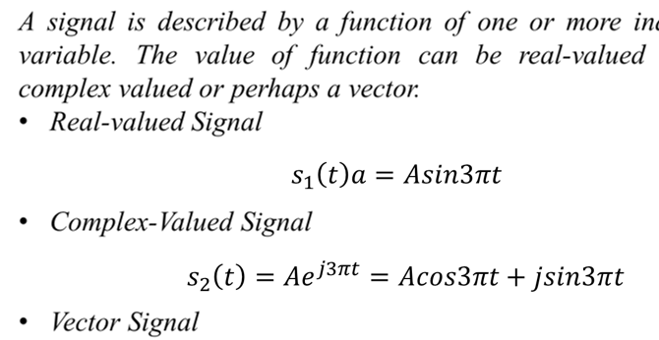
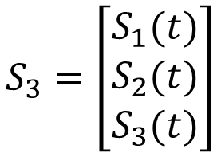
Multichannel and multidimensional Signals

Slide 25
Multichannel and multidimensional Signals
Multichannel Signals
multichannel signals are generated by multiple sources or multiple sensors. The resultant signal is the vector sum of signals from all channels.
A common example of a multichannel signal is ECG waveform.

Slide 26
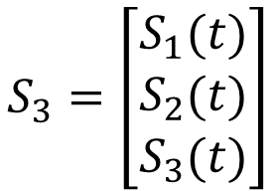

Multichannel and multidimensional Signals
To generate ECG waveform; different leads are connected to the body of a patient. Each lead is acting as an individual channel. Since there are n number of leads; the final ECG waveform is a result of the multichannel signal. mathematically final wave is expressed as,

Slide 27
Multichannel and multidimensional Signals
Multidimensional signals
If a signal is a function of a single independent variable, the signal is called a one-dimensional signal.
On the other hand, if the signal is a function of multiple independent variables then it is called as a multidimensional signal.

Slide 28
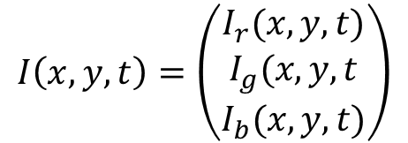
Multichannel and multidimensional Signals
The gray picture is an example of a 2-dimentional signal, the brightness or the intensity I(x,y) at each point is a function of 2 independent variables.
Picture displayed on the TV screen is a “3-dimentional signal”. To locate a pixel on the screen, two coordinates namely x and y are required. Similarly, this point is a function of time also. So to display a pixel, minimum three dimensions are required; namely x, y, and t. Thus this is a multidimensional signal.

Slide 29


Multichannel and multidimensional Signals
ECG signal(Multichannel signal)
TV signal(Multidimensional signal)

Slide 30
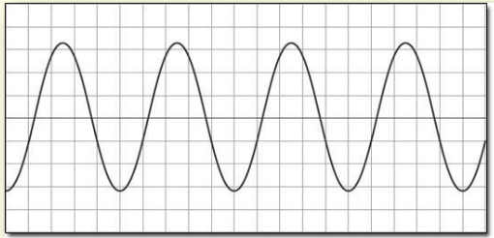
Deterministic versus Random Signals
Deterministic Signal
Any signal whose past, present and future values are precisely known without any uncertainty.
Can be described by an explicit mathematical expression, a table or data, or a well defined rule.
  e.g. sinusoidal signal

Slide 31
Deterministic versus Random Signals
Random Signal
A signal in which cannot be approximated by a formula to a reasonable degree of accuracy (i.e. noise).
The ‘shhhh’ sound is a good example that is rather easy to observe using a microphone and oscilloscope.
Random signals are characterized by analyzing the statistical characteristics across an ensemble of records.
Signal evolve in time in an unpredictable manner
  E.g. seismic signals, speech signals, etc.

Slide 32
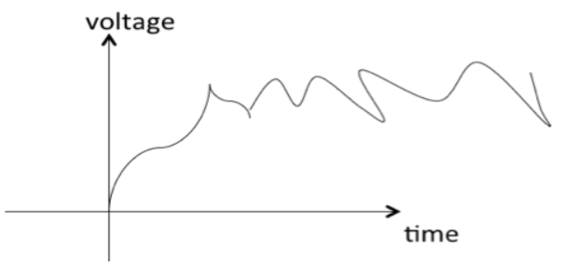
Deterministic versus Random Signals
Random Signal

Slide 33
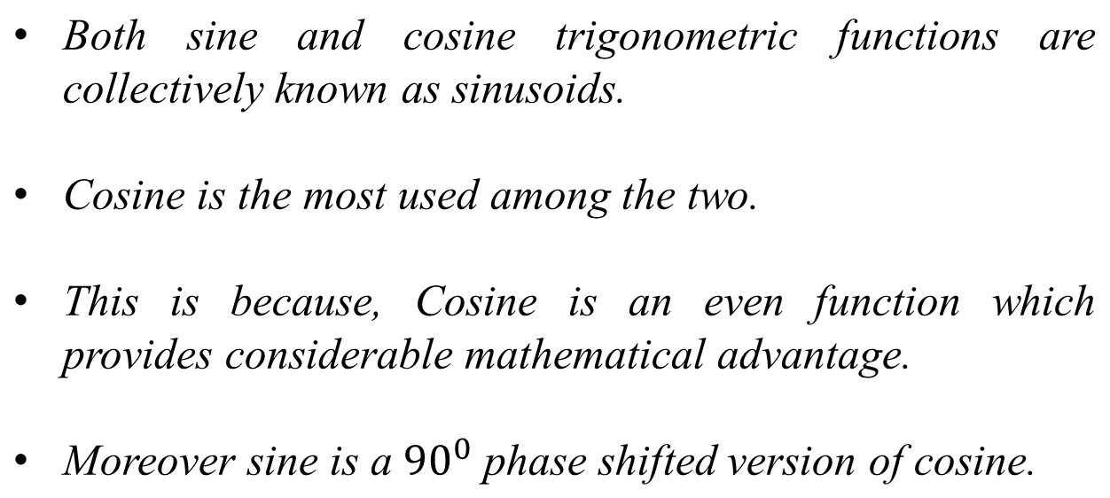
Sinusoidal Signal

Slide 34
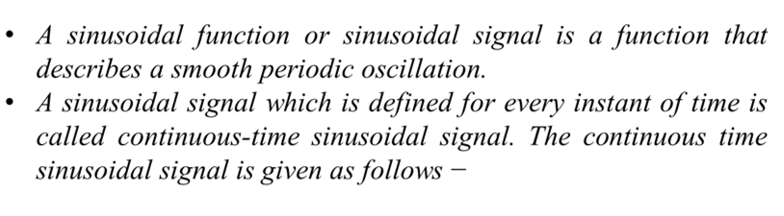
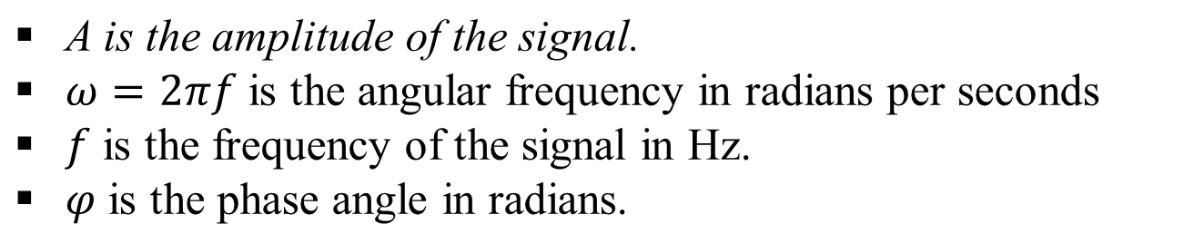
Continuous Time Sinusoidal Signal

Slide 35
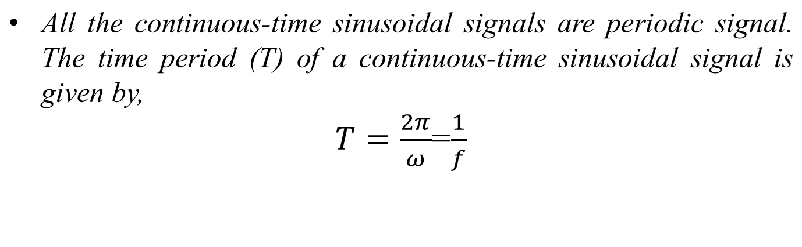
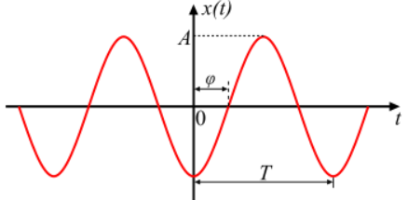
Continuous Time Sinusoidal Signal

Slide 36
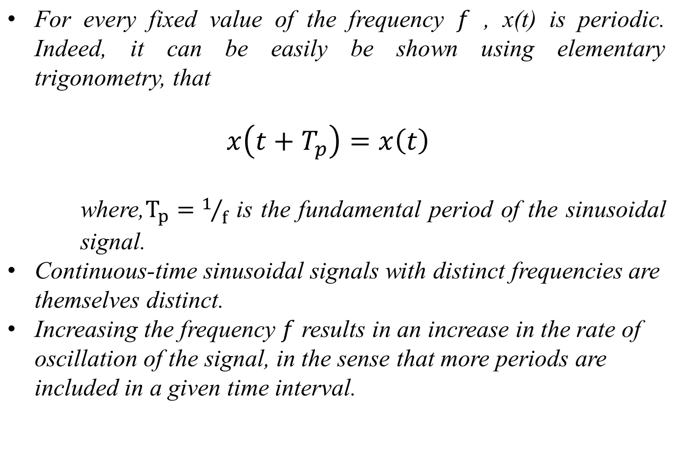
Properties of Continuous Time Sinusoidal Signal

Slide 37
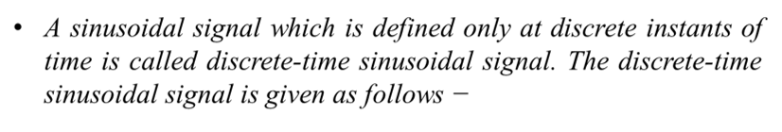
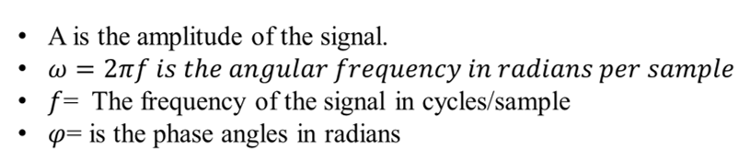

Discrete Time Sinusoidal Signal
A frequency in hertz can be converted to an angular frequency by multiplying it by 2π.

Slide 38
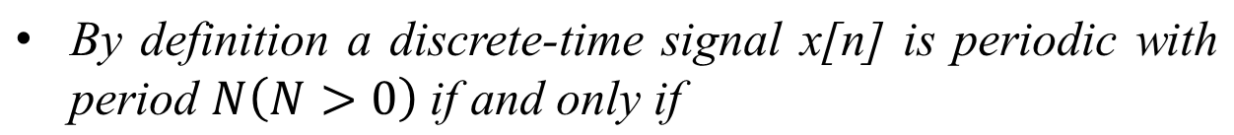
Properties of Discrete Time Sinusoidal Signal
In discrete time period is measured in the number of samples for one “cycle” of the sinusoid. The smallest value for which the above equation is true is called fundamental frequency.

Slide 39
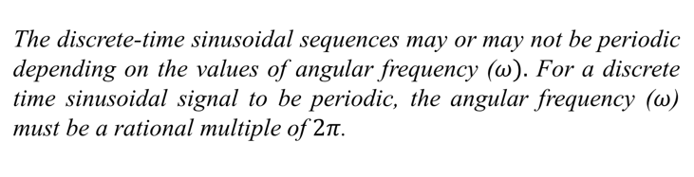
Properties of Discrete Time Sinusoidal Signal

Slide 40
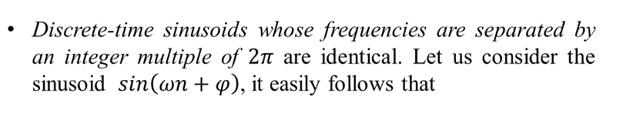
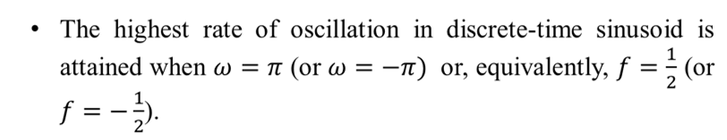
Properties of Discrete Time Sinusoidal Signal

Slide 41
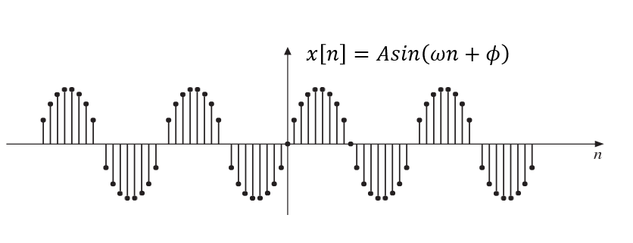
Properties of Discrete Time Sinusoidal Signal

Slide 42
Why Sinusoidal Signal is so Important?
The sinusoidal signals or sinusoidal functions are very important in both electrical and electronics engineering. According to the Fourier series theory, any periodic signal can be written in terms of sinusoidal signals (i.e., sine and cosine signals) of different frequencies. Thus, a complex signal can be converted into simple sine and cosine signals and hence the analysis of the signals becomes easy.
In the mathematical operations of signals, the sinusoidal signal is the only signal whose summation, multiplication, differentiation or integration be also a sinusoidal signal.

Slide 43
Fundamentals >> System
A system is defined as an entity that acts on an input signal and transforms it into an output signal.
A system is also defined as a set of elements or fundamental blocks which are connected together and produces an output in response to an input signal. It is a cause-and-effect relation between two or more signals.
Systems may be single-input and single-output systems or multi-input and multi-output systems.

Slide 44
Fundamentals >> Digital Signal Processing
Digital signal processing (DSP) is the method of processing signals and data in order to enhance, modify, or analyze those signals to determine specific information content. It involves the processing of real-world signals that are converted to, and represented by, sequences of numbers.

Slide 45
Fundamentals >> Digital Signal Processing
Digital signal processor may be a large programmable digital computer or a small microprocessor programmed to perform the desired operations on the input signal.
It may also be a hardwires digital processor, configured to perform a specific set of operations on the input signal,

Slide 46
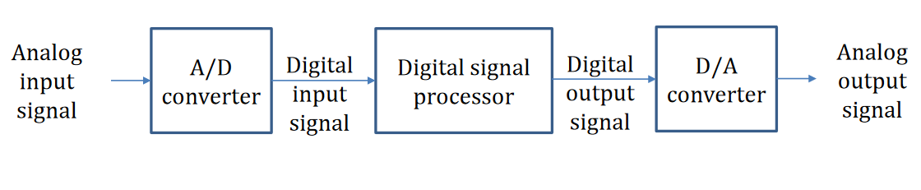
Block Diagram of DSP

Slide 47
Advantages of DSP
The application of digital computation to signal processing allows for many advantages over analog processing in many applications, such as error detection and correction in transmission as well as data compression.
Digital signal processing is also fundamental to digital technology, such as digital telecommunication and wireless communications.
DSP is applicable to both streaming data and static (stored) data.

Slide 48
Drawbacks of DSP
Though the advantages are many, there are some drawbacks associated with processing a signal in digital domain. Digital processing needs ‘pre’ and ‘post’ processing devices like analog-to-digital and digital-to-analog converters and associated reconstruction filters. This increases the complexity of the digital system.
Also, digital techniques suffer from frequency limitations. Processing of signals beyond higher frequencies (beyond GHz) and below lower frequencies (a few Hz) involves limitations.

Slide 49
Drawbacks of DSP
Digital systems are constructed using active devices (Diode, Transistor, ICs, DC generator, Current & Voltage sources etc.) which consume power whereas analog processing algorithms can be implemented using passive devices (Resistor, Capacitor, Inductor, Transformer, Motors etc.) which do not consume power. Moreover, active devices are less reliable than passive components.
Information is lost because we only take samples of the signal at intervals.

Slide 50
Application of DSP
Telecommunication: Echo cancellation in telephone, video conferencing, cellular phone, Fax.
Consumer Electronics: Digital audio, electronic music, FM stereo application.
Image Processing: Image compression, image enhancement, image analysis.
Medical field: Medical diagnostic instrumentation such as CT-Scan, MRI etc.
Military
Speech Processing

Slide 51
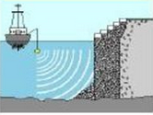
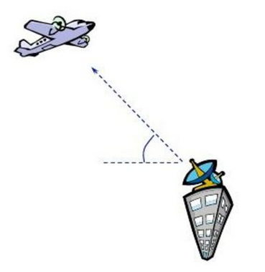
Application of DSP-Radar and Sonar
Tracking
Target detection: Position and velocity estimation.

Slide 52



Application of DSP-Speech
Noise reduction: Reducing background
noise in the sequence produced by a
sensing device (microphone).
Speech Recognition: Differentiating between various speech sounds.
Synthesis of artificial speech: Text to speech system for blinds.

Slide 53
End

